Slide 1
Preparing for ESOS Phase Two
Applying the lessons learnt in Phase One
John Pooley – ESOS Lead Assessor (RPEC)
edie Energy Management Forum 2018 - BIRMINGHAM

Slide 2
Agenda
 | 1 | Introduction - A little about me
 | 2 | ESOS Recap
 | 3 | Lessons from Phase One
 | 4 | Phase Two time-line
 | 5 | Identifying opportunities
 | 6 | Minimizing risk & getting maximum financial value
 | 7 | Help from the Energy Institute

Slide 3



A little about me
Managing Director – John Pooley Consultancy Ltd
Eur Ing, CEng & Fellow of Energy Institute
Certified Management Consultant & Fellow Institute of Consultancy
ESOS – sectors covered
Car hire; care homes; construction; financial services; food & drink; international airline; international charity; IT services; logistics; manufacturing; pharmaceuticals; tourist attractions.
Roles: Lead Assessor; Energy Auditor; Compliance Audit ‘trouble-shooter’

Slide 4
ESOS Re-cap
2

Slide 5
ESOS Re-cap
83 pages of guidance into one slide!
The Energy Savings Opportunity Scheme Regulations 2014 - established to implement Article 8 (4 to 6) of the EU Energy Efficiency Directive (2012/27/EU)
ESOS applies to ‘large’ undertakings
(defined by either one or both of the following)
    250 or more employees
    an annual turnover in excess of €50 million (£38,937,777) and an annual balance sheet total in excess of €43 million (£33,486,489)
Covers all energy used by the organization – i.e. buildings, processes and transport – Total Energy Consumption (TEC)
Compliance Routes: ISO 5000; Energy audits; DECs; Green Deal Assessments
De Minimis: Up to 10% of total energy can be excluded
Lead Assessor: – can be internal or external – Not required if 100% is covered by ISO 50001
Administered by
    England – Environment Agency ;Northern Ireland – Northern Ireland Environment Agency; Scotland – Scottish Environment Protection Agency; Wales – Natural Resources Wales
Phase One compliance date: 5 December 2015; Phase Two compliance date: 5 December 2019
No mandatory requirement to implement recommendations

Slide 6
Essential vocabulary
Compliance date
Reference Year
Total Energy Consumption (TEC)
Significant Energy Use (SEU)
De Minimis

Slide 7
Lessons from Phase One
3

Slide 8
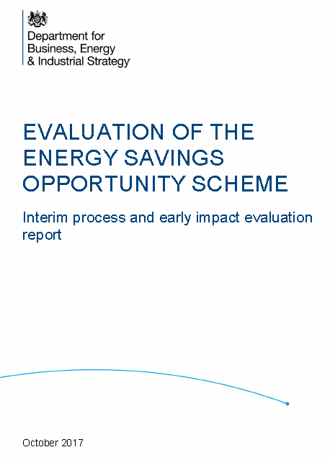
.
Notes:
Research on Auditing & Reporting including ESOS
BEIS has commissioned external research on the effectiveness of energy audits and energy reporting in driving energy efficiency savings in organisations. In addition, this work will evaluate the impact of the Energy Savings Opportunity Scheme (ESOS), following on from the interim ESOS evaluation published in October. An important part of this research is gathering the views of stakeholders.
As part of this work Ipsos Mori with the Carbon Trust and University College London, will be running a series of workshops and conducting qualitative interviews with business and industry, starting from December 2017 and running into April 2018. Further evaluation work on ESOS will start in summer 2018 and continue to 2019

Slide 9
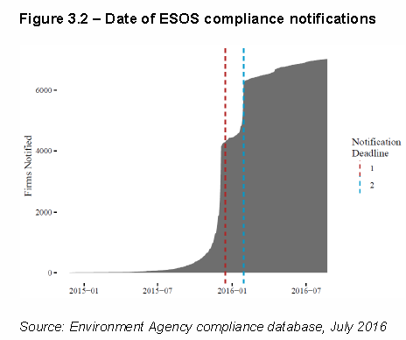
Notes:
“Factors contributing to delayed compliance were mostly internal to organisations (stemming from ESOS being a low business priority or as structural complexities led to longer decision-making around how to comply), but in a few cases external factors such as the availability of assessors to conduct site visits contributed.”

Slide 10
Enforcement
Environment Agency Newsletter December 2017
Tackling non-compliance
Investigated ~2,400 organizations
‘Gained’ ~240 participants through Enforcement Notices
‘On-going’ – 190 Enforcement Notices cases
Commenced civil penalty proceedings
About 6% of ‘qualifying organizations’ have received enforcement notices

Slide 11
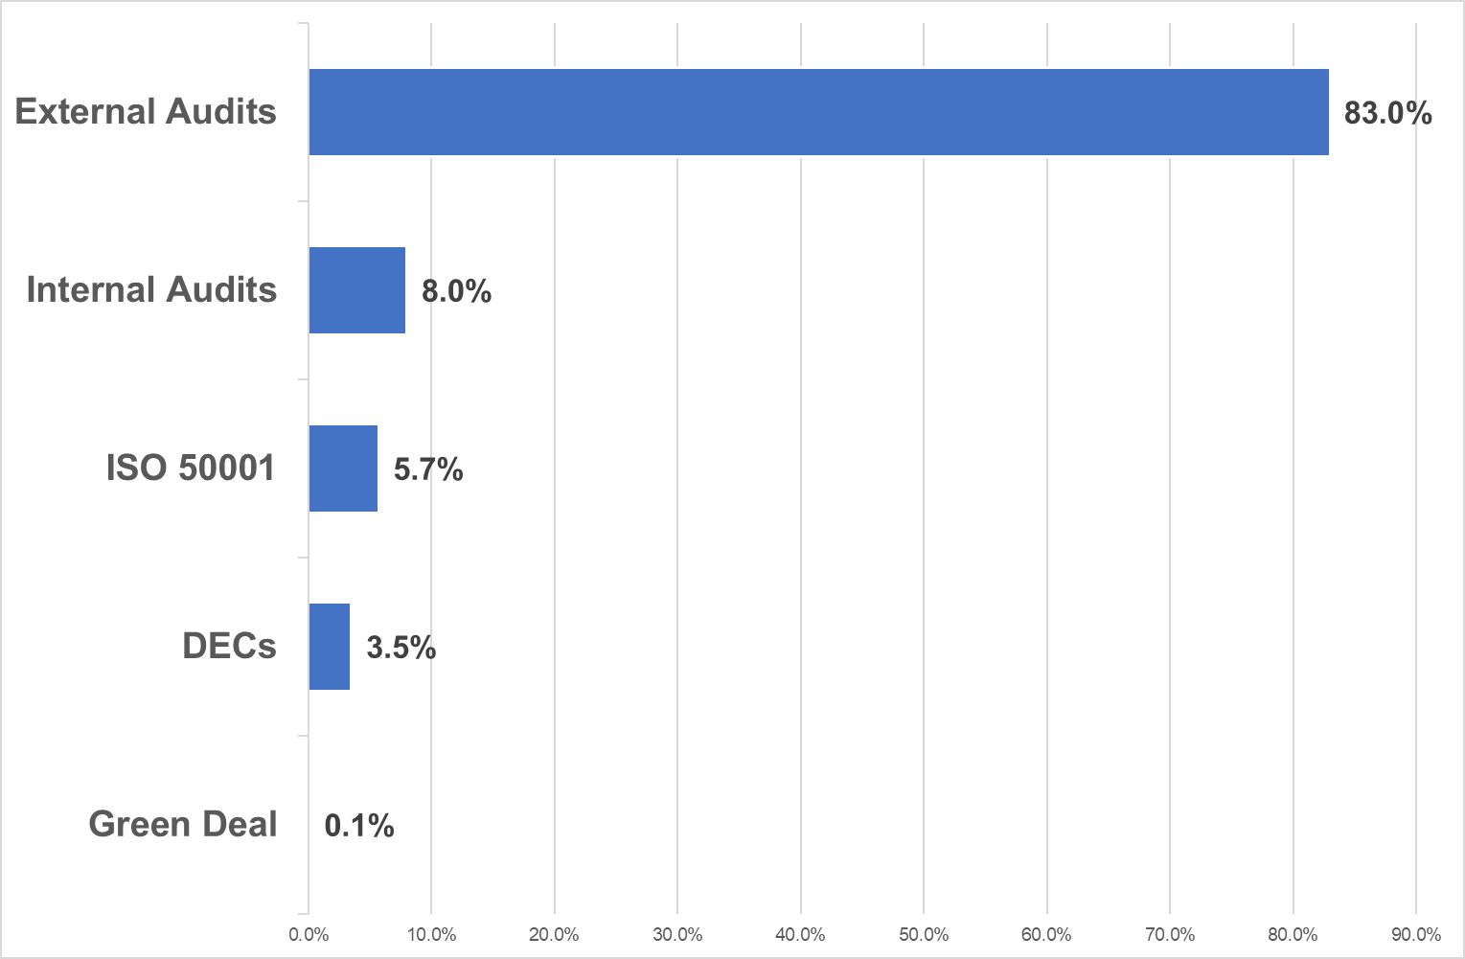
Compliance Routes

Slide 12
Lessons from Phase One (1)
The need to understand the regulations and guidance
    A significant number or organizations and some Lead Assessors did not fully understand/apply the official guidance
Being fully aware of your corporate structure
    A significant number of non-compliances were as a result of overlooking parts of the organization. There is a need to involve company secretaries or others that fully understand the legal framework of the organization. Internal communication an issue.
  ‘Accuracy’ needed in calculating Total Energy Consumption
    It is critical to fully identify 100% of energy use
The Phase One timescale may have led to a ‘simple compliance’ approach
    ESOS is on a four year cycle and there can be ‘continuity’ of work in that period

Slide 13
Lessons from Phase One (2)
  Broader understanding in the organization of the need to comply
    Some Finance Departments acted as if ESOS were optional
    Difficulties in providing data
  Review management options as well as technology
    Many audits were ‘light’ on management aspects and focussed on ‘popular’ technical fixes
Integrate ESOS as a strategic issue
    Many organizations viewed ESOS as a compliance exercise and not a strategic part of their energy management programme and doing so did not maximise the benefits of the process
Not all Lead Assessors are equal

Slide 14
Phase Two Time-line
4

Slide 15
Phase Two - Key Dates
Qualification date – 31 December 2018
Compliance date – 5 December 2019

Slide 16
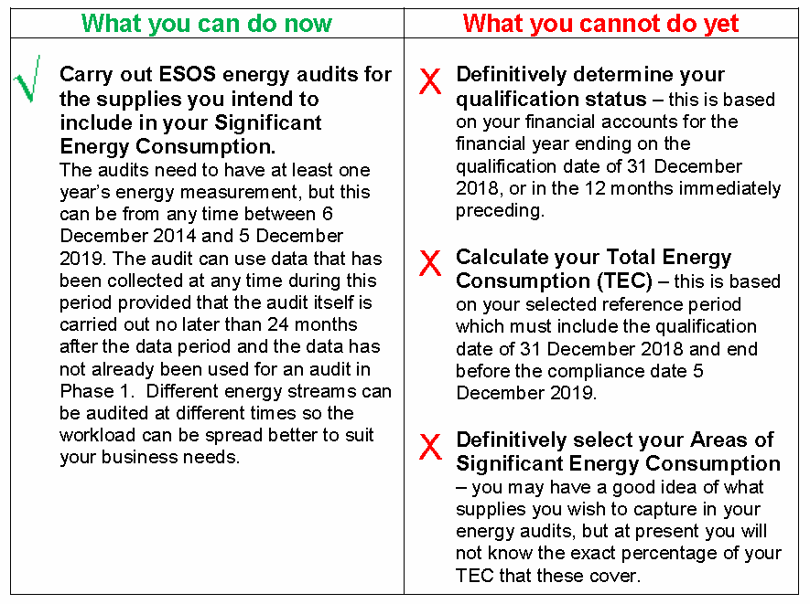
What you can do now
Note use of word definitively
Source: Environment Agency

Slide 17
Identifying Opportunities
5

Slide 18
Identifying Opportunities
Note: ESOS is an energy based regulation, not a carbon based one, a clue is in the name Energy Savings Opportunities
However, a auditor could be ‘remiss’ if they overlooked renewable energy opportunities.
The scope for this is something to be agreed with the client at the outset.

Slide 19
Identifying Opportunities
Review Phase One Audit Reports
Management - buildings, processes and transport
    Policy and planning
    Measurement and reporting – M&T
    Measurement & verification – M&V
    Behaviour, culture & training
Operational
    Reviewing settings – HVAC, BEMS, process, etc.
    Review procedures – buildings, processes and transport
Technology
    LED lighting & controls
    Variable Speed Drives & motors
    Refrigeration based systems
    EC fans

Slide 20
Minimizing risk & gaining maximum financial value
6

Slide 21
7 Steps to minimize risk and maximize benefits
Review your ‘current ESOS status’
    Review the evidence pack from Phase One
    Identify ALL parts of the organization, also determine if you will aggregate or disaggregate
Decide on compliance route
    100% coverage with ISO 50001 will be fully compliant and no Lead Assessor required
      Note: Revised version of ISO 50001 expected summer 2018
  Appoint a Lead Assessor (unless 100% ISO 50001)
    Review track record of Lead Assessor; early involvement of the Lead Assessor is worthwhile

Slide 22
7 Steps to minimize risk and maximize benefits
  Review data collection and reporting – undertake a preliminary TEC and SEU analysis
    1 January 2018 to 31 December 2018 is the ‘earliest’ reference year you can have
  Start your audit programme now
    Make the audits work for you, not just ESOS
  Integrate ESOS into you operations
    ESOS is a legal requirement but it can be leveraged to provide additional value if integrated
  Keep informed about ESOS developments
    Environment Agency Newsletter; Google Alerts; Your Lead Assessor; Energy Institute

Slide 23
Help from the Energy Institute
7

Slide 24
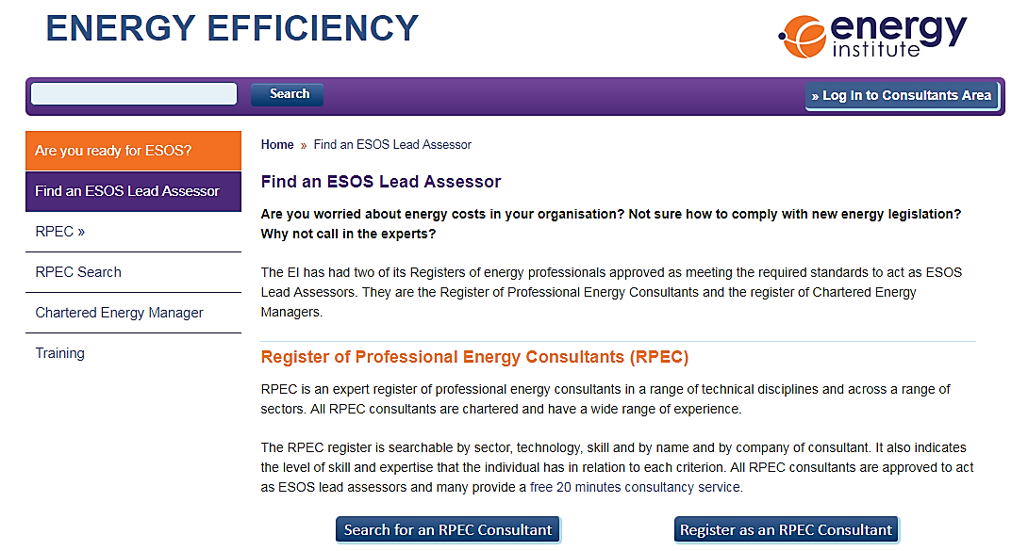
EI ESOS Lead Assessors
The EI has had two of its Registers of energy professionals approved as meeting the required standards to act as ESOS Lead Assessors:
      Register of Professional Energy Consultants (RPEC)
      Chartered Energy Managers
Finding an EI ESOS Lead Assessor
    https://efficiency.energyinst.org/esos-lead-assessor

Slide 25
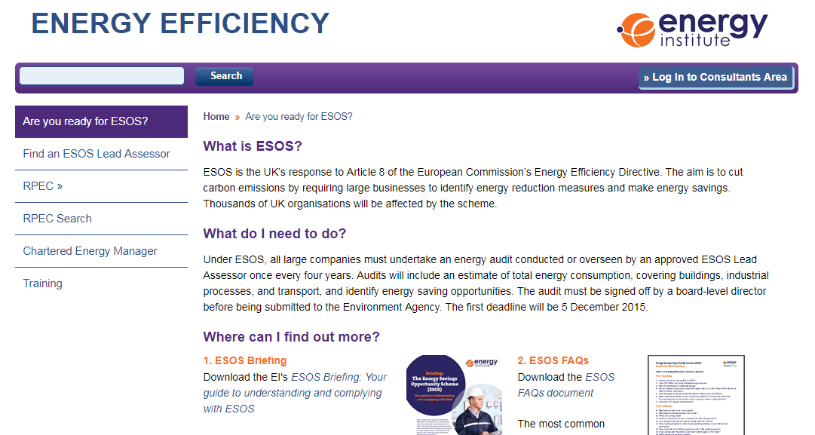
EI ESOS Resources
EI Efficiency website:
      ESOS Briefing
      ESOS FAQs
      Link to full guidance
      ESOS Toolkit
      RPEC Helpline
https://efficiency.energyinst.org/ESOS

Slide 26
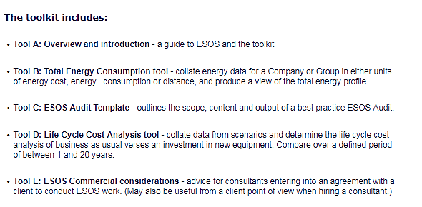
Toolkit
For more information on the ESOS toolkit, please contact the EI’s training team at webtraining@energyinst.org

Slide 27
The Approved Registers of ESOS Lead Assessors
Association of Energy Engineers – certified energy auditor international CEA-I; certified energy manager international (CEM-I)
Chartered Institution of Building Services Engineers – (CIBSE) CIBSE low carbon consultant (LCC) register, ESOS lead assessor subset
ECMK Ltd - ECMK ESOS lead assessor register
Elmhurst Energy Systems – Elmhurst approved ESOS lead assessor
Energy Institute (EI) – Chartered Energy Manager; Register Of Professional Energy Consultants (RPEC)
Institution of Chemical Engineers – Register of Chartered Chemical Engineers (MIChemE/FIChemE) ESOS LEA
Institution of Environmental Sciences – IES lead energy assessor
National Energy Services Limited – National Energy Services ESOS register
Quidos – ESOSRegister.com
Stroma Certification Ltd – ESOS lead energy assessor certification
The Energy Managers Association – EMA energy saving opportunity scheme lead assessor register
The Institute of Environmental Management and Assessment – environmental auditor and full membership of IEMA (ESOS lead assessor subset); principal environmental auditor (ESOS lead assessor subset)

Slide 28
If you only go away with 4 points from this session……
Understand the guidance
Get a good Lead Assessor
Integrate the ESOS process into your organization
If you have not already, start now!

Slide 29
Preparing for ESOS Phase Two
Applying the lessons learnt in Phase One
John Pooley – ESOS Lead Assessor (RPEC)
edie Energy Management Forum 2018, BIRMINGHAM
E-mail: john@pooleyconsult.net

